Slide 1
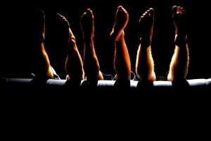
PHYSICAL THEATRE
Year 8 Drama
Lesson 3
Storytelling

Slide 2
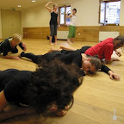
LESSON OBJECTIVE:
To be able to tell a story through the use of physical theatre

Slide 3
KEYWORDS
Lesson Objective:
To be able to tell a story through the use of physical theatre
To understand how to perform a piece of physical theatre.
Physicalisation
Atmosphere
Sound effects

Slide 4
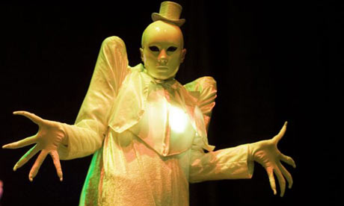
What skills did we learn in the previous lesson
Lesson Objective:
To be able to tell a story through the use of physical theatre
To understand how to perform a piece of physical theatre.
Achievement points awarded to students who remember.
Create a mechanical
machine

Slide 5
Quick Questions
Lesson Objective:
To be able to tell a story through the use of physical theatre
To understand how to perform a piece of physical theatre.
What do we mean by an ‘image’?
Why are bodies a good way to create images?
Can anyone give an example of physical theatre where images have been created?
Talk Talk adverts

Slide 6
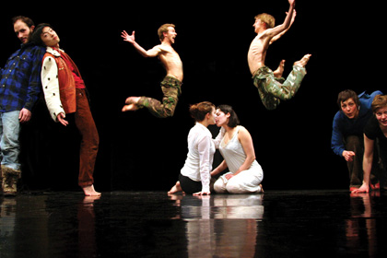
RECAPPING TRUST
Lesson Objective:
To be able to tell a story through the use of physical theatre
To understand how to perform a piece of physical theatre.
STAGE 1:We want to encourage each other to try riskier things so we need to establish trust amongst the group.
In pairs, students fall back into their partners arms (swap over) students must be focused to make it work
STAGE 2:In 4's, one person in the middle and they get pushed from one person to another. They then fall, get caught and pushed forward into someone else.
How did this help with trust?
How did you do it safely?

Slide 7
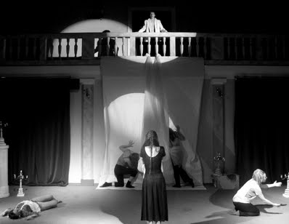
Creating a Story
Lesson Objective:
To be able to tell a story through the use of physical theatre
To understand how to perform a piece of physical theatre.
Teacher uses 5 students to model how to physicalise the first part of the story to the whole class.
In groups of 5/6 students are then given different parts of the story about a haunted house. Using their bodies only, students must recreate the story.
One person can narrate, but they must consider their voice they
e.g. How might a door sound in a haunted house?
How might it sound if it was your own house?
Groups have 8 minutes per section of the story and 5 minutes to run through the whole story.

Slide 8
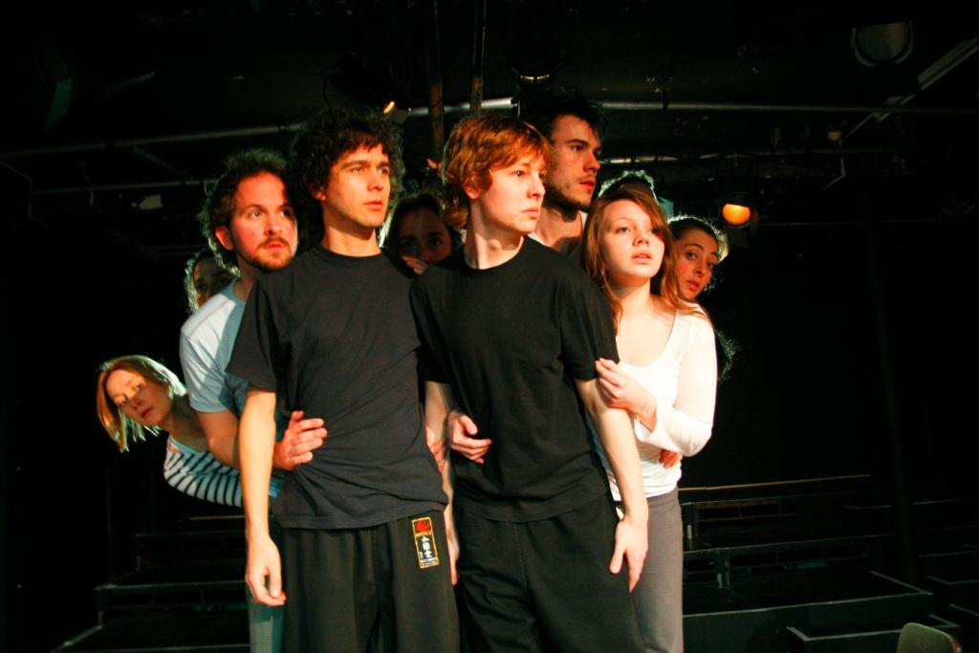
Performance
Lesson Objective:
To be able to tell a story through the use of physical theatre
To understand how to perform a piece of physical theatre.
Each group performs their story to the rest of the class – Mid way assessment
Each group is allocated one other group to evaluate

Slide 9
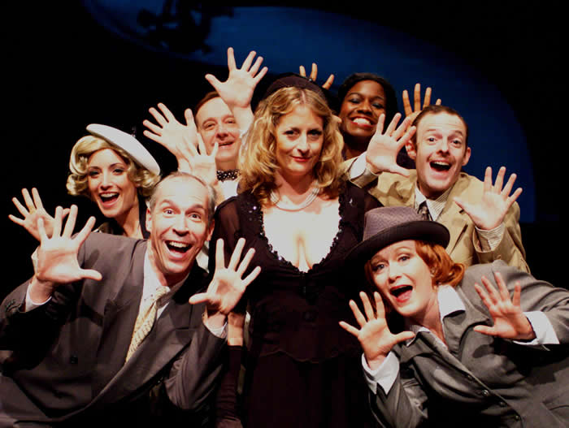
Feedback
Lesson Objective:
To be able to tell a story through the use of physical theatre
To understand how to perform a piece of physical theatre.
Each group feedbacks to the group they evaluated answering the following questions:
How did the group use physical theatre to create the image?
How did the group create an atmosphere?
How was it a different interpretation from your own group?

